Slide 1

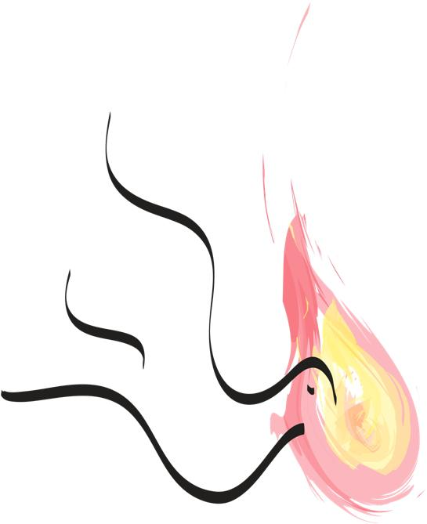
[Title]
[Lyrics and Chords]
[Copyright Info]
Notes:
Intro:
G
I hear the Saviour say
D G
Thy strength indeed is small.
(G) C
Child of weakness watch and pray
G D G
Find in me thine all in all.

